Slide 1
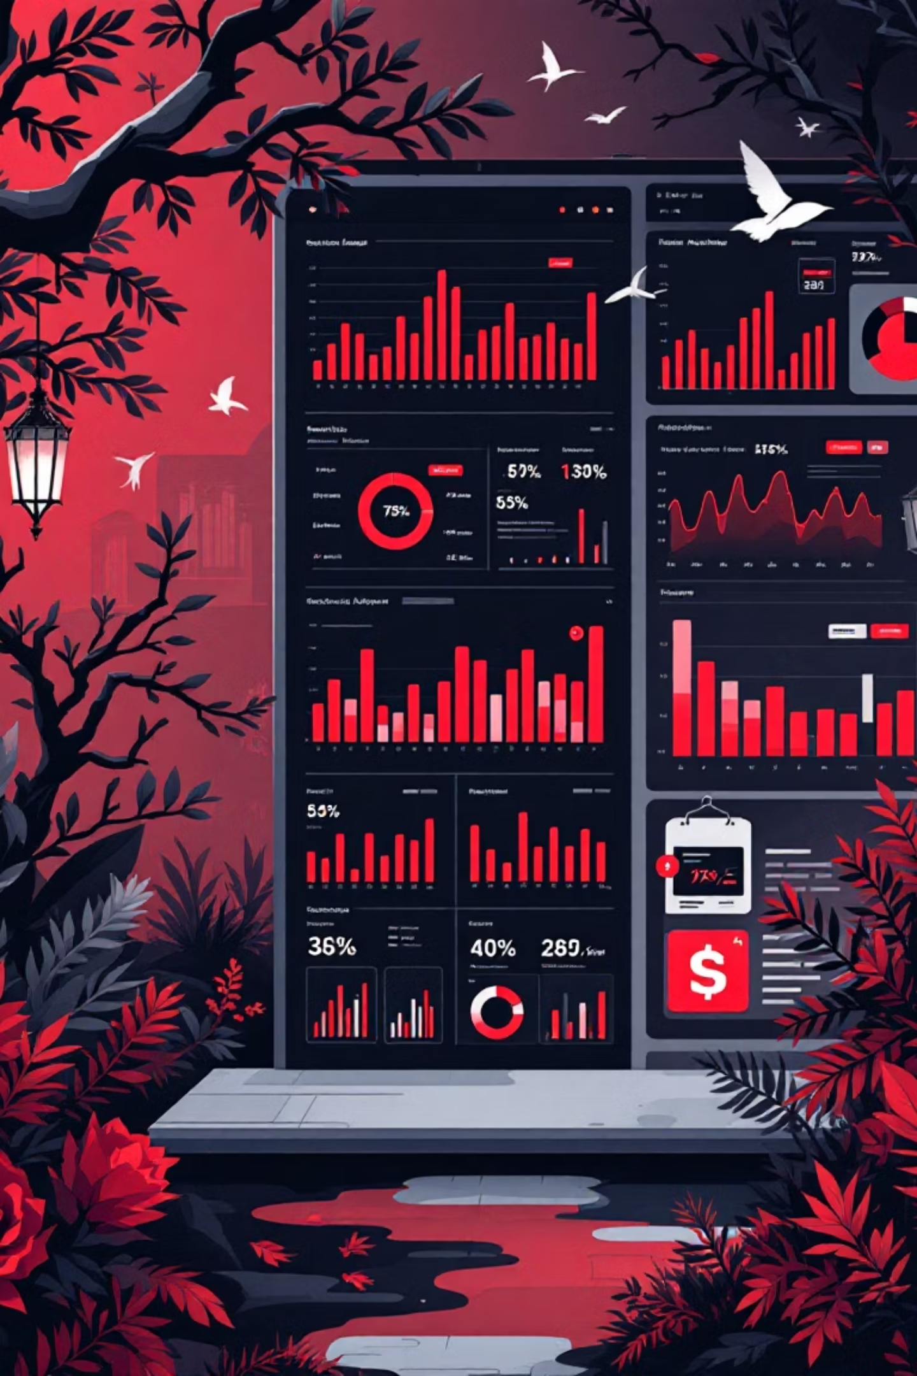
Customer Shopping Behavior Analysis
Uncovering insights from 3,900 purchases to drive strategic business decisions

Slide 2
Dataset Overview
3,900
18
37
Total Purchases
Data Points
Missing Values
Transactions analyzed
Features per transaction
In review ratings only
Customer Data
Transaction Details
Age, Gender, Location
Product, Category, Amount
Subscription Status
Season, Size, Color
Purchase History
Discounts & Promotions

Slide 3





Data Preparation Pipeline
Data Loading
Imported dataset using pandas
Exploration
Structure check and summary statistics
Cleaning
Handled missing values, standardized columns
Engineering
Created age groups and frequency metrics

Slide 4
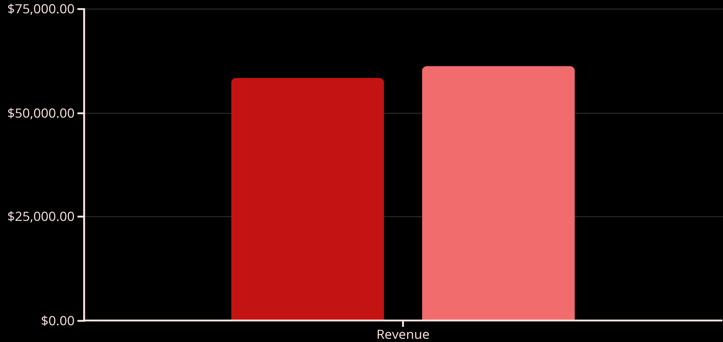
Revenue Insights
Gender Comparison
Female customers generate slightly higher total revenue
Shipping Preference
Express shipping users spend $15 more on average per purchase
Male
Female

Slide 5

Top-Rated Products
Blouse
Jewelry
Pants
4.2 average rating
4.1 average rating
4.0 average rating
Dress
Shirt
3.9 average rating
3.9 average rating
Highest-rated products show consistent quality across apparel and accessories

Slide 6


Subscription Impact
68%
45%
Higher Spend
Repeat Rate
Subscribers spend more per transaction
Customers with 5+ purchases likely to subscribe
Subscribers
Non-Subscribers
Average spend: $72
Average spend: $43
Total revenue: $156,000
Total revenue: $98,000

Slide 7



Customer Segmentation
Loyal
5+ purchases
Returning
2-4 purchases
New
1 purchase
Understanding customer lifecycle enables targeted retention strategies

Slide 8

Discount Strategy Analysis
High-Value Discount Users
Customers using discounts still spend above average
Discount-Dependent Products
Handbag: 67% discounted
Jewelry: 65% discounted
Coat: 63% discounted
Dress: 62% discounted
Sweater: 61% discounted
Balance promotional activity with margin protection for sustainable growth

Slide 9
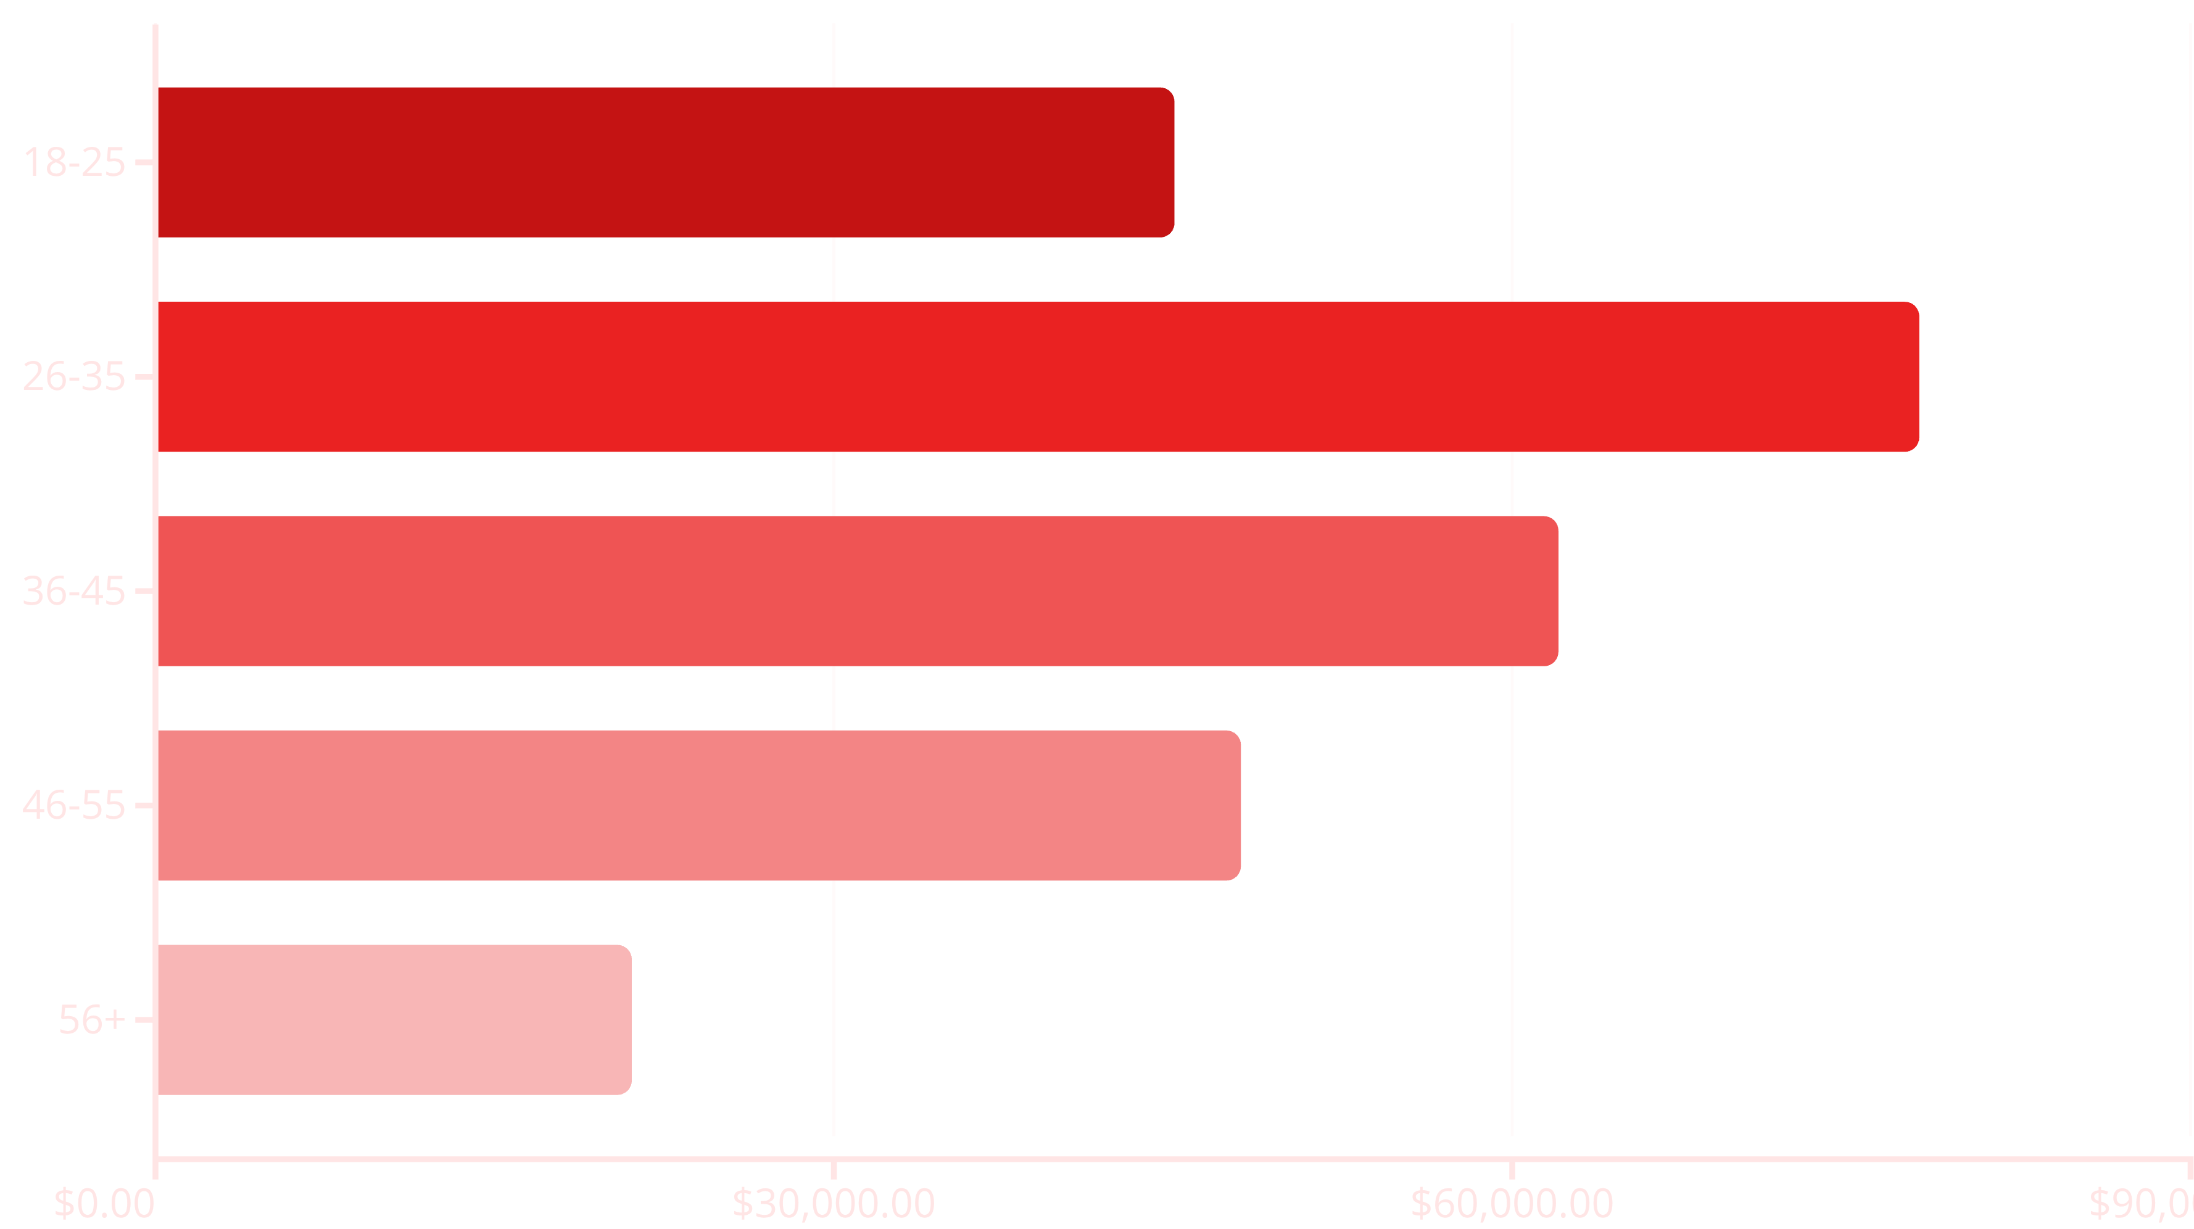
Age Group Revenue Distribution
26-35 age group drives highest revenue—prime target for marketing campaigns

Slide 10
Strategic Recommendations
1
2
3
Boost Subscriptions
Loyalty Programs
Optimize Discounts
Promote exclusive benefits to convert high-frequency buyers
Reward repeat buyers to accelerate movement into loyal segment
Balance promotional sales with margin control for profitability
4
5
Product Positioning
Targeted Marketing
Highlight top-rated and best-selling items in marketing campaigns
Focus on 26-35 age group and express-shipping users

